Slide 1
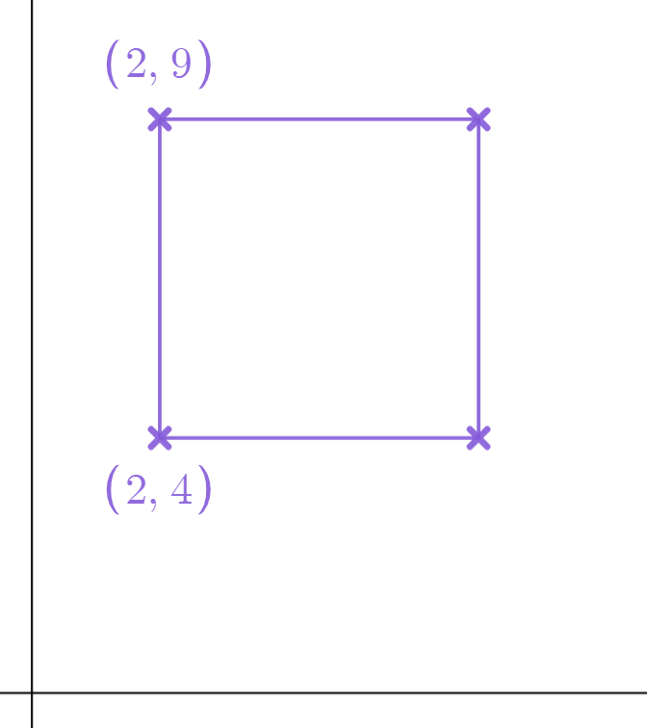
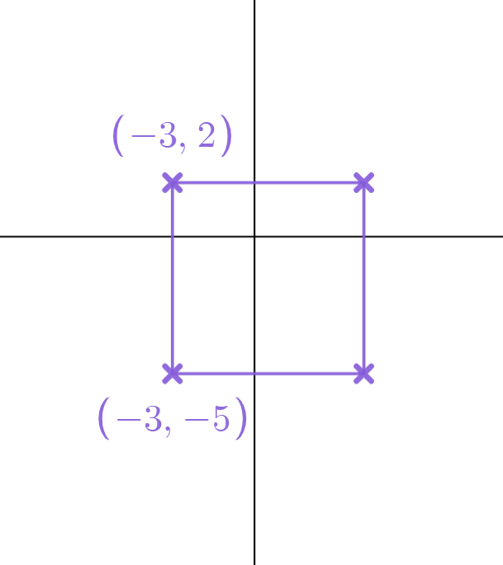
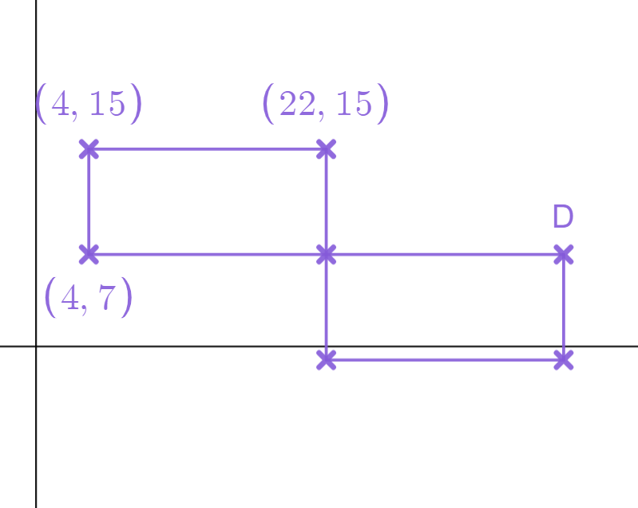
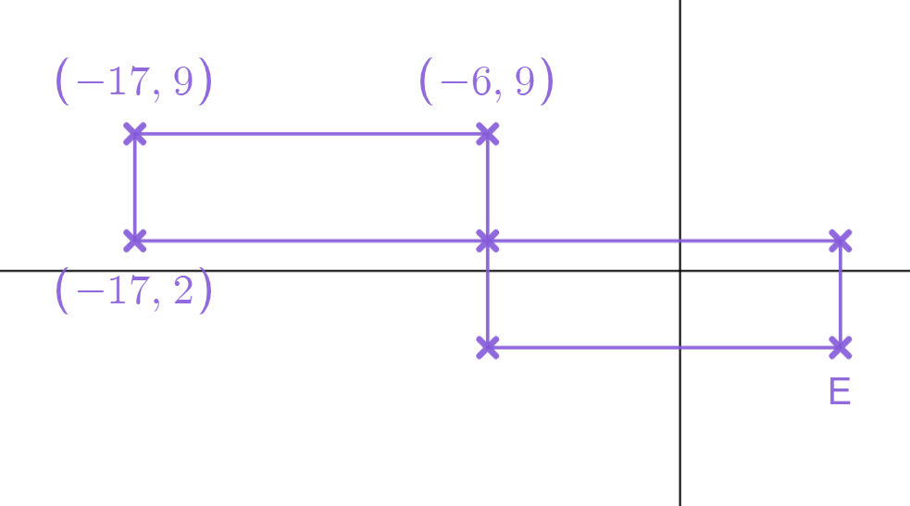
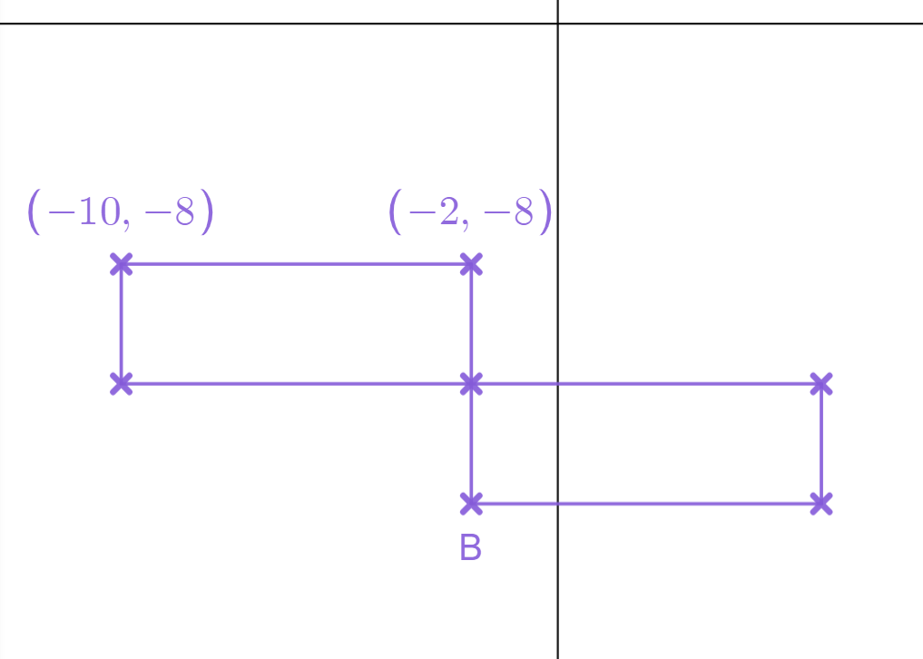
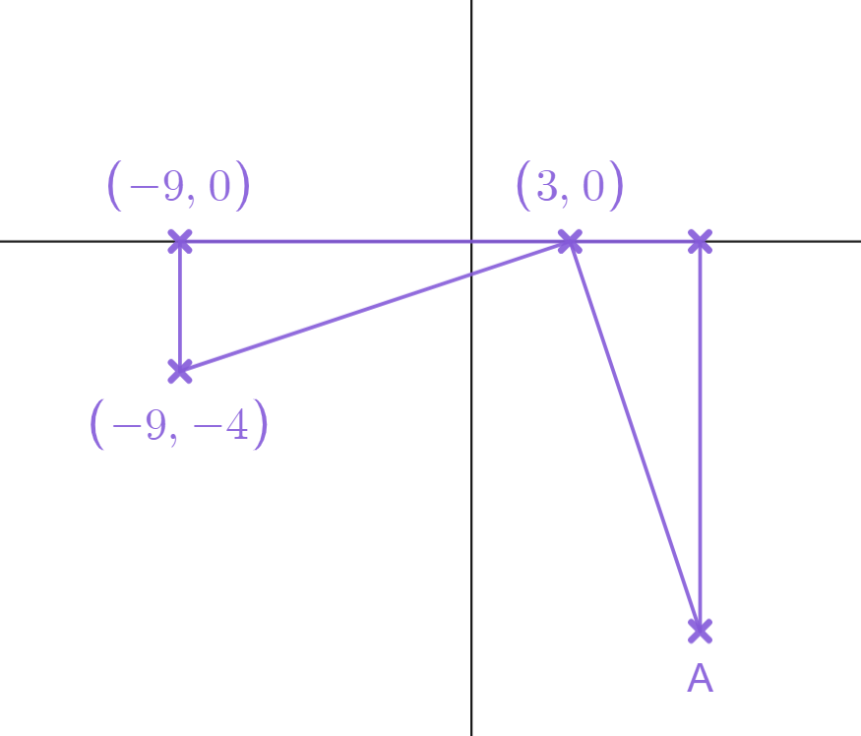
Problem solving with plotting coordinates
Task A: Calculating horizontal and vertical distance
Work out the missing coordinates to make each shape a square.
a)
b)
5
(7,9)
7
(4,2)
5
7
(7,4)
(4,-5)
2a) These two rectangles are the same size. Work out the missing coordinate D.
2b) These two rectangles are the same size. Work out the missing coordinate E.
18
11
7
11
(5,2)
18
7
(40,7)
(5,-5)
2c) These two rectangles are the same size. The length is double the width. Work out the missing coordinate B.
2d) Below are two identical triangles. Work out the missing coordinate A.
8
12
4
(7,0)
4
4
4
12
(-2,-16)
(7,-12)

Slide 2



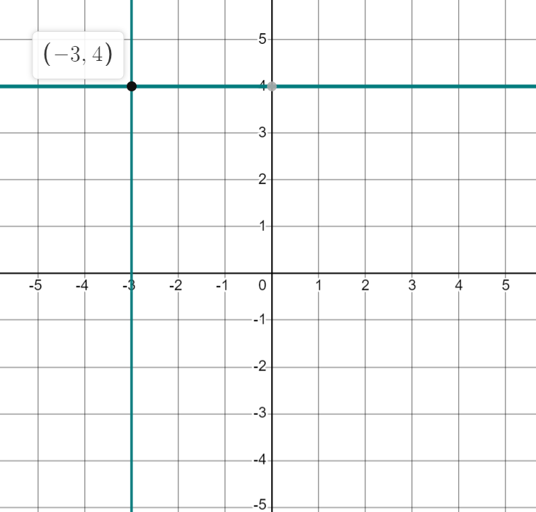
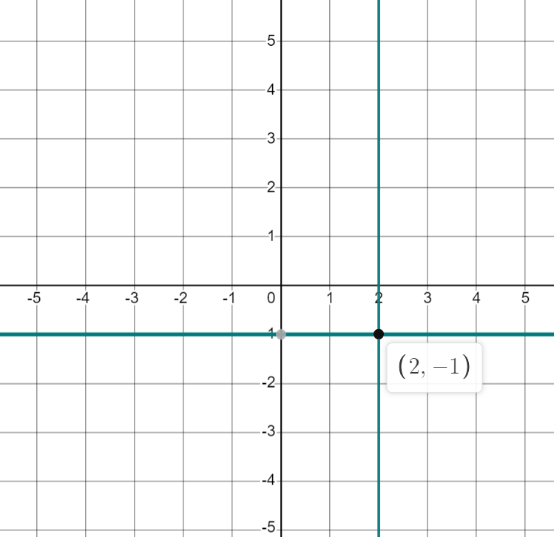
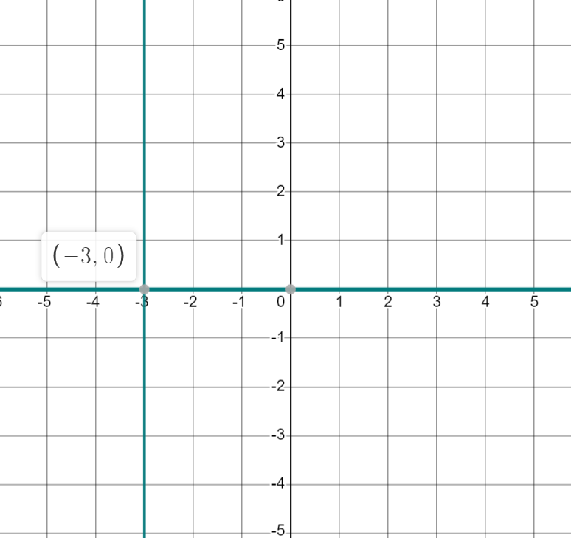



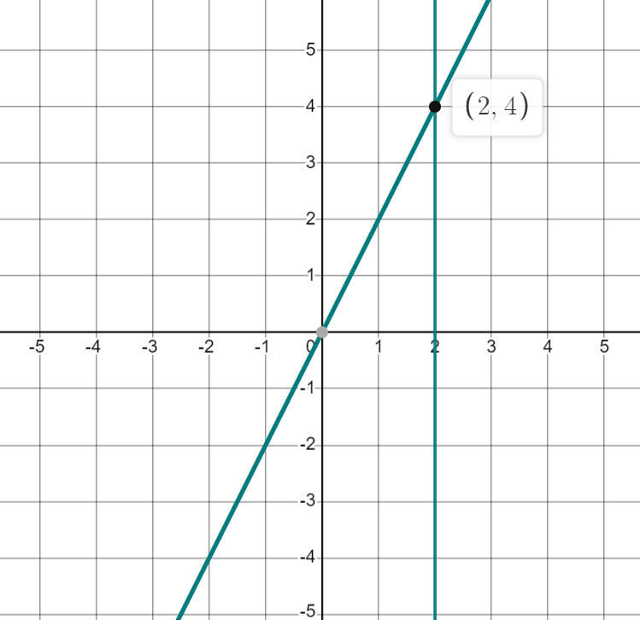
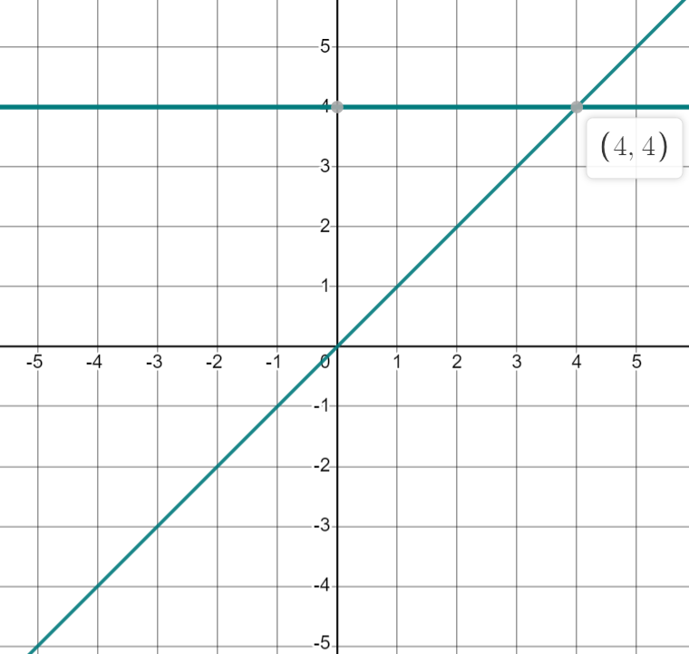
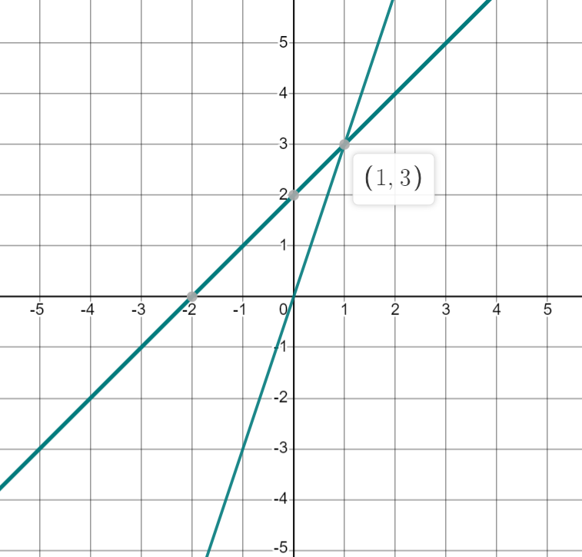
Problem solving with plotting coordinates
Task B: Finding the coordinates where two lines intersect
Find a coordinate that follows both rules. You may wish to use the axes to help.
a)
b)
c)
(-3,4)
(2,-1)
(-3,0)
Find a coordinate that follows both rules. You may wish to use the axes to help.
d)
e)
f)
(2,4)
(4,4)
(1,3)
v2.2

Slide 3










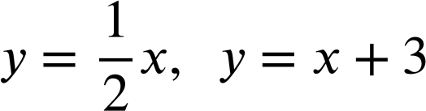
Problem solving with plotting coordinates
2) Where do each pair of lines intersect?
(list some coordinates that fit the rules to help you)
a)
b)
c)
d)
e)
f)
(4,9)
(1,2)
(3,6)
(5,10)
(-1,-2)
(0,0)
g)
h)
i)
j)
k)
(3,3)
(2,-2)
(-2,2)
(2,8)
(-6,-3)
Mathematics in Education and Industry.

